Slide 1
Persuasion
Presentation and its Impact on Learners

Slide 2
Persuasion: Context Matters
The effectiveness of a persuasive argument depends on…
Who delivers the message (peer / authority / antagonist)
What media is used to present the information (visual / audio / tactile)
How the information is contextualized (phrasing / colors / experience)
When & where the delivery occurs (class / playground / home)
Education is most effective when we employ persuasion in delivery!

Slide 3

Message Framing
Framing is the structure we use to deliver information. It includes…
Motivation (Financial, Value-based, Personal Fulfillment)
Framework (Social, Natural)
Utility (Loss vs Gain)
The effectiveness of how a communicator addresses motivation, selects a framework, and describes utility will vary according to topic.

Slide 4
Persuasive Approaches
Aristotle identified three major approaches to persuading an audience.
Ethos appeals to social constructs (authority / tradition)
Pathos appeals to emotions (empathy / sympathy)
Logos appeals to logic (deduction / induction)
Even though scientists like to think of themselves as logical, social constructs and emotion play an enormous role in teaching and science!

Slide 5


Ethos: Just Trust Me
Ethos techniques turn on the communicator’s credibility, including…
Social standing / position (tradition)
Predisposition of audience related to speaker (rapport)
Physical objects that lend credibility where applicable (artifacts)

Slide 6

Pathos: The Feels
Pathos persuasion techniques depend on building an emotional connection:
Myths, Legends, Parables, & Anecdotes (storytelling)
Slogans, Jargon (catchphrases)
Reframing / repositioning (spin)

Slide 7
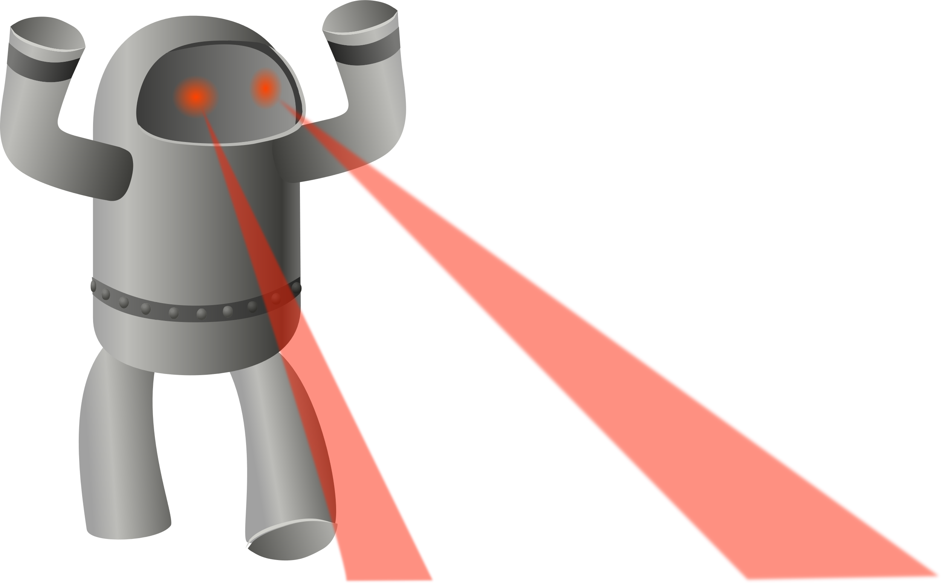
Logos: Cold, Heartless Calculation
Logos persuasion focuses on building an argument by appealing to logic:
Metaphor, Simile (analogy)
Comparison, Reflection (contrast)
Deduction, Induction, Contradiction (proof)
Note that analogy and contrast techniques are susceptible to logical fallacy when improperly employed.

Slide 8

Other Techniques: Audience-Centric
Persuasion techniques can also focus on the specific audience:
Audience Consideration
Objection Anticipation
Heliotropic Appeal

Slide 9
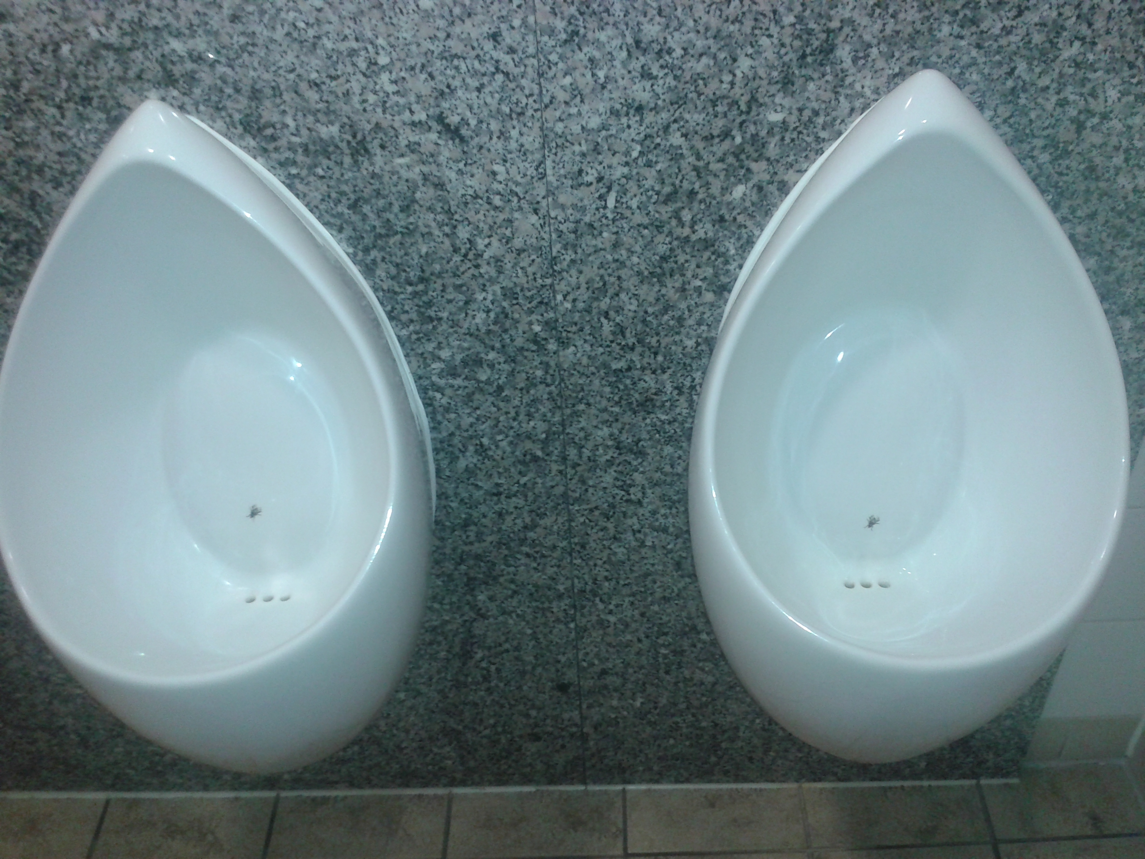
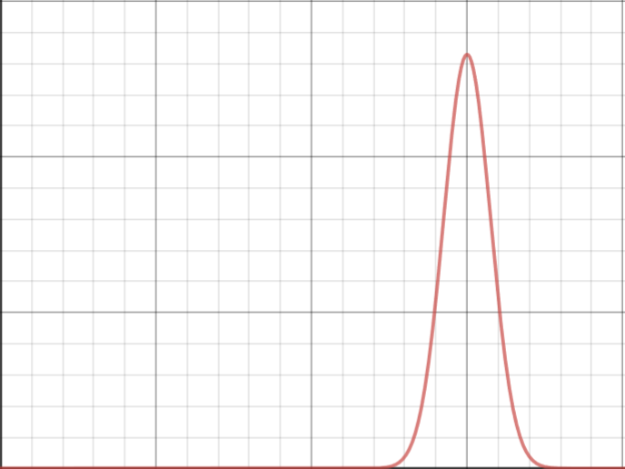

Other Techniques: Human Psychology
We can also use general human thinking patterns to our benefit:
Rule of Three
Peak-End Rule
Nudge Theory

Slide 10
Persuasion in Practice
We need to consider context, framing, and technique:
Who is our audience, and what motivates them?
What techniques are they most amenable to?
Why should they listen to us?
To engage and teach, we need social, emotional, & logical strategies!

